Slide 1
Deep Learning
Session 2

Slide 2
Agenda:
1 | Deeper Neural Networks and Hidden Layers
2 | Overfitting and Regularization Techniques
3 | Optimization Techniques

Slide 3
Deeper Neural Networks and Hidden Layers

Slide 4
Deeper Neural Networks and Hidden Layers
What is a Deep Neural Network (DNN)?
A Deep Neural Network (DNN) is simply a neural network with more than one hidden layer between the input and output layers. These hidden layers enable the network to learn more complex patterns and features from the data. The addition of more layers allows the network to model hierarchical patterns, making DNNs powerful for tasks like image classification, speech recognition, and natural language processing.

Slide 5
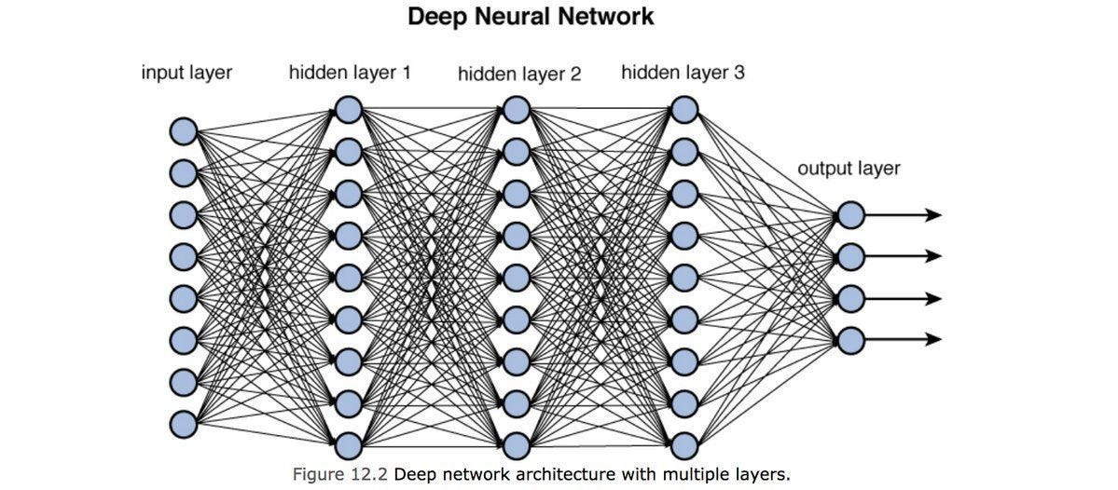
Deeper Neural Networks and Hidden Layers
What is a Deep Neural Network (DNN)?

Slide 6
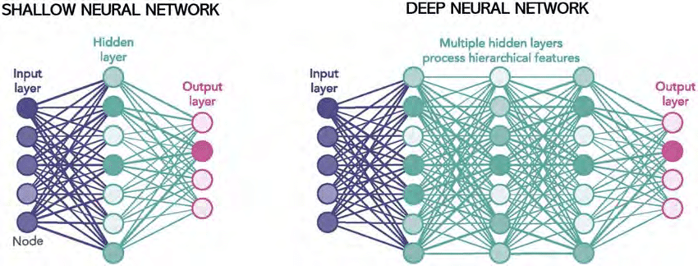
Deeper Neural Networks and Hidden Layers
Why Add More Hidden Layers?
Simple Patterns in Shallow Networks: A shallow neural network (with only one or two hidden layers) can only learn relatively simple patterns. For example, it may be able to differentiate between basic shapes in images.

Slide 7
Deeper Neural Networks and Hidden Layers
Why Add More Hidden Layers?
Complex Patterns in Deep Networks: Adding more hidden layers enables the network to learn complex hierarchical representations. Each layer builds on features learned in previous layers :
The first layer may detect edges or basic features.
The second layer may detect shapes and contours.
The deeper layers may detect more complex features like objects or faces.
The deeper the network, the more complex and abstract the learned features become.

Slide 8
Deeper Neural Networks and Hidden Layers
How Data Passes Through a Deep Neural Network
In a deep neural network, data passes through multiple layers of neurons. Each layer performs the following :
1. Weighted Sum
Each neuron receives inputs from the previous layer and calculates a weighted sum.

Slide 9
Deeper Neural Networks and Hidden Layers
How Data Passes Through a Deep Neural Network
In a deep neural network, data passes through multiple layers of neurons. Each layer performs the following :
2. Activation Function
The weighted sum is passed through an activation function (e.g., ReLU, Sigmoid, Tanh) to introduce non-linearity.

Slide 10
Deeper Neural Networks and Hidden Layers
How Data Passes Through a Deep Neural Network
In a deep neural network, data passes through multiple layers of neurons. Each layer performs the following :
3. Output of Layer
The result is passed to the next layer as input, and this continues until the output layer.

Slide 11
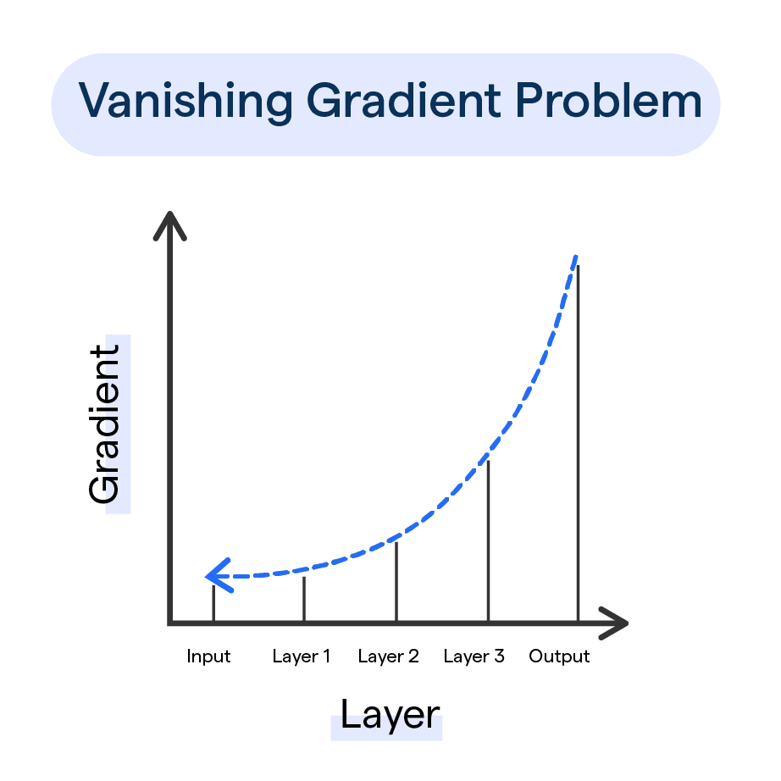
Deeper Neural Networks and Hidden Layers
Vanishing Gradient Problem
The Vanishing Gradient Problem occurs during the training of deep neural networks, especially when using certain activation functions. It happens when the gradients of the loss function become very small (close to zero) as they are propagated back through the layers. As a result, the earlier layers in the network receive extremely small updates during training, making it difficult for the model to learn effectively in those layers.

Slide 12
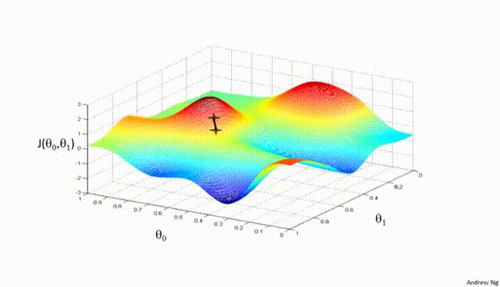
Deeper Neural Networks and Hidden Layers
Vanishing Gradient Problem

Slide 13
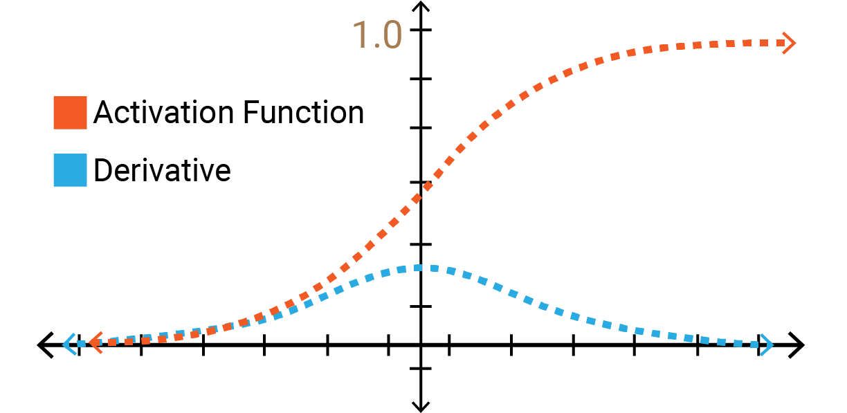
Deeper Neural Networks and Hidden Layers
How Activation Functions Affect the Vanishing Gradient Problem ?
Different activation functions have varying effects on the vanishing gradient problem. Let's break down how common activation functions like Sigmoid, Tanh, and ReLU handle this issue.

Slide 14

Deeper Neural Networks and Hidden Layers
Sigmoid Activation Function
What is Sigmoid?
The sigmoid function maps any input to a value between 0 and 1, and is defined as :
Where 𝑧 is the input (usually the weighted sum of inputs in a neuron).

Slide 15

Deeper Neural Networks and Hidden Layers
How Does Sigmoid Cause Vanishing Gradients?
Output Saturation: The sigmoid function saturates at both ends of its range. When the input z is large and positive, the output is close to 1. When z is large and negative, the output is close to 0.
Gradient: The derivative of the sigmoid function is:
This derivative is very small when z is large in magnitude (either positive or negative), meaning that the gradient for neurons in these regions becomes very small.
For inputs far from 0, the gradient of sigmoid becomes very close to 0, leading to vanishing gradients during backpropagation.

Slide 16
Deeper Neural Networks and Hidden Layers
How Does Sigmoid Cause Vanishing Gradients?
Effect on Deep Networks
In deep networks, layers closer to the input receive much smaller gradient updates, slowing down the training process significantly or even stopping learning altogether.

Slide 17
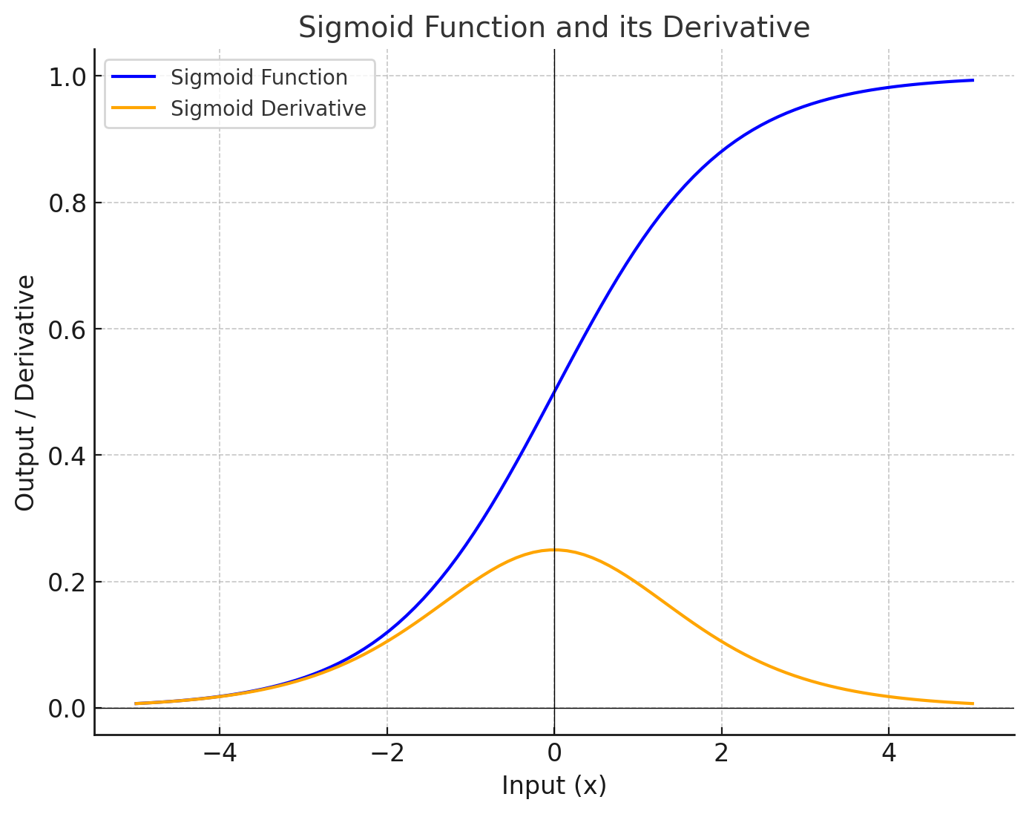
Deeper Neural Networks and Hidden Layers
How Does Sigmoid Cause Vanishing Gradients?
The plot shows the Sigmoid Function (blue) and its Derivative (orange).
The gradient (derivative) becomes very small when input values are far from 0 (both negative and positive).
For large positive or negative input values, the derivative approaches zero.
This behavior leads to the vanishing gradient problem, where gradients become too small during backpropagation, slowing down learning in deep neural networks.

Slide 18

Deeper Neural Networks and Hidden Layers
Tanh Activation Function
What is Tanh?
The Tanh (hyperbolic tangent) function maps any input to a value between -1 and 1. It is defined as :

Slide 19

Deeper Neural Networks and Hidden Layers
How Does Tanh Handle Vanishing Gradients?
Output Range: Like the sigmoid function, tanh can suffer from the vanishing gradient problem, but it does better than sigmoid in some cases because its output is centered around zero (-1 to 1), which helps to maintain a mean of zero for activations, allowing for faster convergence.
Gradient: The derivative of the tanh function is :
Like sigmoid, the gradient becomes very small for inputs with large magnitudes, resulting in the same issue of vanishing gradients. However, because its output range is [-1, 1] instead of [0, 1], it tends to perform slightly better in deeper networks.

Slide 20
Deeper Neural Networks and Hidden Layers
How Does Tanh Handle Vanishing Gradients?
Effect on Deep Networks
While tanh is an improvement over sigmoid due to its zero-centered output, it still suffers from vanishing gradients for deep networks. The further from 0 the inputs are, the smaller the gradients, and the slower the training becomes for earlier layers.

Slide 21
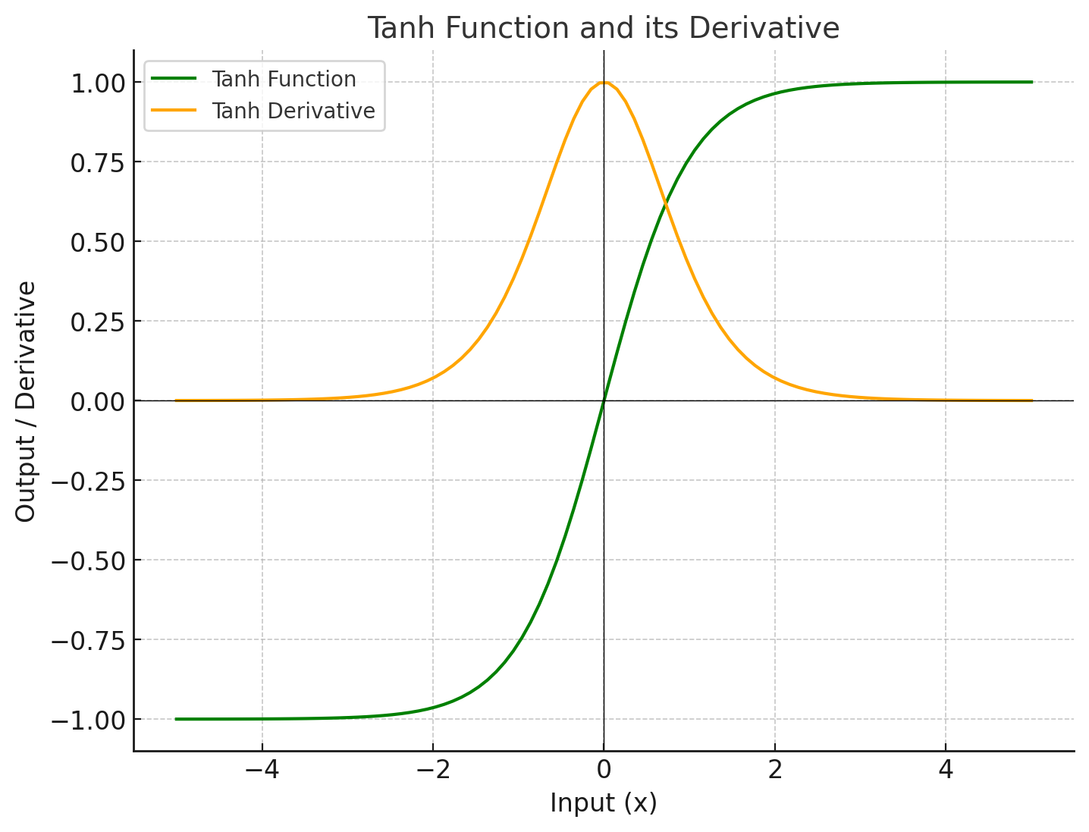
Deeper Neural Networks and Hidden Layers
How Does Tanh Handle Vanishing Gradients?
Tanh Function ranges between -1 and 1, which helps maintain a mean of zero for activations.
The Derivative of Tanh becomes very small for inputs with large magnitudes, leading to vanishing gradients for large positive or negative inputs, similar to the Sigmoid function. However, since its output is centered around zero, it tends to perform better than Sigmoid in deeper networks

Slide 22

Deeper Neural Networks and Hidden Layers
ReLU (Rectified Linear Unit) Activation Function
What is ReLU?
The ReLU activation function is defined as :
ReLU is a piecewise linear function that returns the input value if it is positive, and 0 if the input is negative.

Slide 23

Deeper Neural Networks and Hidden Layers
How Does ReLU Handle Vanishing Gradients?
No Saturation for Positive Inputs: The key difference with ReLU is that it does not saturate for positive values. The gradient of ReLU is :
This means that for positive inputs, the gradient remains 1, preventing the vanishing gradient problem and allowing for faster learning.

Slide 24
Deeper Neural Networks and Hidden Layers
Advantages of ReLU
Efficient Gradient Flow: Because ReLU has a gradient of 1 for positive inputs, the gradient does not shrink as it propagates through the network, enabling more effective weight updates.
Sparsity: ReLU sets negative values to 0, which introduces sparsity in the network. Sparse representations can make the network more efficient and can also help prevent overfitting.

Slide 25
Deeper Neural Networks and Hidden Layers
Potential Issue: Dying ReLU Problem
While ReLU solves the vanishing gradient problem, it has its own issue called the Dying ReLU Problem. If a neuron consistently receives negative inputs, its output will be 0, and its gradient will be 0. Once this happens, the neuron may stop learning entirely.
To address this, variants of ReLU like Leaky ReLU or Parametric ReLU introduce a small negative slope for negative inputs, preventing neurons from "dying."

Slide 26
Deeper Neural Networks and Hidden Layers
How Does ReLU Handle Vanishing Gradients?
Effect on Deep Networks
ReLU has become the most commonly used activation function in deep networks because it avoids the vanishing gradient problem. It allows gradients to flow efficiently through the network, leading to faster and more reliable training, especially for deep architectures.

Slide 27
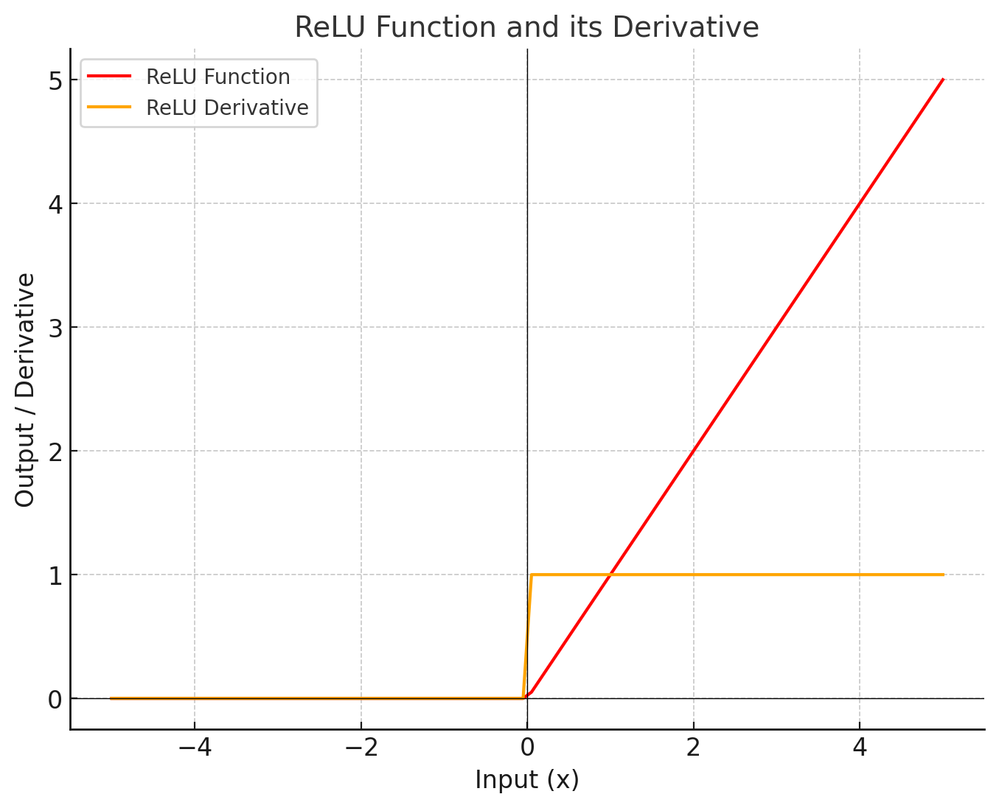
Deeper Neural Networks and Hidden Layers
How Does ReLU Handle Vanishing Gradients?
ReLU Function does not saturate for positive inputs, meaning it continues to grow linearly as input values increase.
The Derivative of ReLU is 1 for positive inputs and 0 for negative inputs. This prevents the vanishing gradient problem for positive values, allowing for faster learning in deep networks.

Slide 28
Overfitting and Regularization Techniques

Slide 29
Overfitting and Regularization Techniques
What is Overfitting?
Overfitting occurs when a neural network learns not only the underlying patterns in the training data but also the noise and outliers. As a result, the network performs very well on the training data but fails to generalize to new, unseen data (test or validation data).
In simple terms, overfitting happens when the network is too complex (e.g., too many parameters) for the available training data, leading it to memorize the data rather than generalize it.

Slide 30
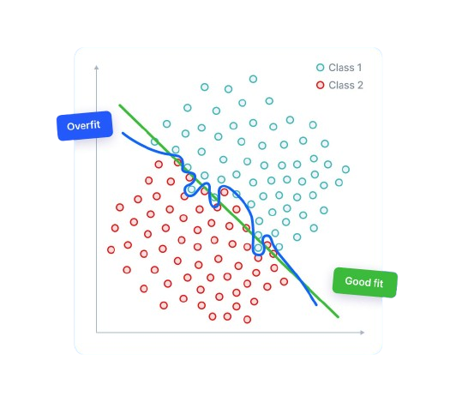
Overfitting and Regularization Techniques
What is Overfitting?

Slide 31
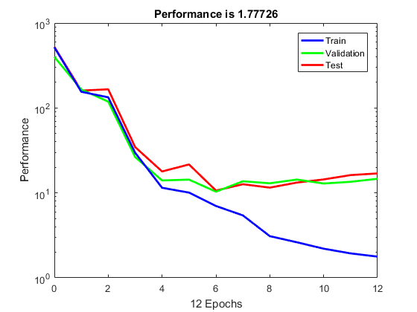
Overfitting and Regularization Techniques
Signs of Overfitting
Low training error, but high validation/test error.
The network performs very well on the training data but poorly on unseen data.

Slide 32
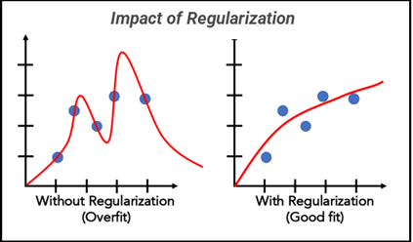
Overfitting and Regularization Techniques
Regularization Techniques to Combat Overfitting
To prevent overfitting, we can use several regularization techniques. These techniques prevent the model from being too complex and help it generalize better to new data.

Slide 33
Overfitting and Regularization Techniques
1. L2 Regularization (Weight Decay)
How it works ?
L2 regularization adds a penalty to the loss function based on the sum of the squared weights.
Why it helps ?
This discourages the network from assigning very high values to weights, effectively reducing the model complexity and preventing overfitting.

Slide 34

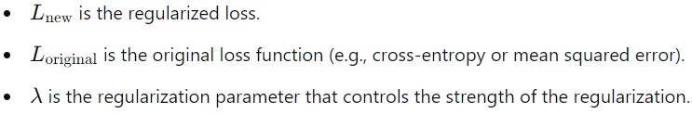
Overfitting and Regularization Techniques
1. L2 Regularization (Weight Decay)
Loss Function with L2 Regularization
Where :

Slide 35
Overfitting and Regularization Techniques
2. L1 Regularization
How it works ?
L1 regularization adds the sum of the absolute values of the weights to the loss function.
Why it helps ?
It can lead to sparse models, where some weights become zero, effectively simplifying the model by selecting important features and eliminating unnecessary ones.

Slide 36

Overfitting and Regularization Techniques
2. L1 Regularization
Loss Function with L1 Regularization

Slide 37
Overfitting and Regularization Techniques
3. Dropout
How it works ?
Dropout randomly "drops" (sets to zero) a fraction of neurons during each forward pass of training. This prevents neurons from relying too much on each other and forces the network to learn more robust representations.
Why it helps ?
Dropout introduces redundancy, which makes the network more robust to noise and less likely to overfit the training data.
During training, a dropout rate (e.g., 0.5) is set, and during each training iteration, random neurons are deactivated with that probability.

Slide 38
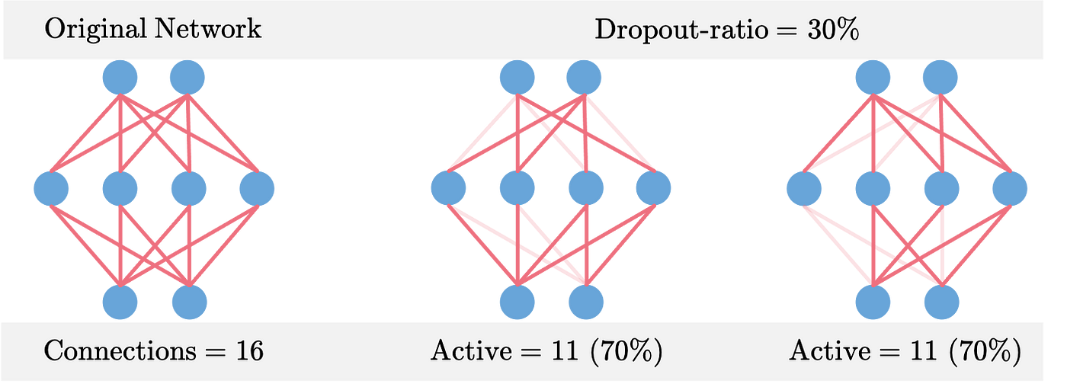
Overfitting and Regularization Techniques
3. Dropout

Slide 39
Overfitting and Regularization Techniques
4. Early Stopping
How it works ?
Early stopping is a simple yet effective technique where training is stopped when the validation error starts to increase, even if the training error continues to decrease.
Why it helps ?
This prevents the model from continuing to learn noise and overfit the training data.
Typically, the validation loss is monitored, and when it starts increasing for several epochs, training is stopped.

Slide 40
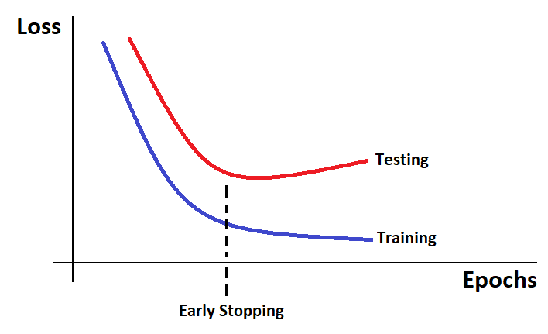
Overfitting and Regularization Techniques
4. Early Stopping

Slide 41
Optimization Techniques

Slide 42
Optimization Techniques
The goal of optimization is to minimize the loss function and improve the network's predictions. Gradient Descent is a widely used optimization algorithm, but several variants exist that can speed up and improve the training process.

Slide 43
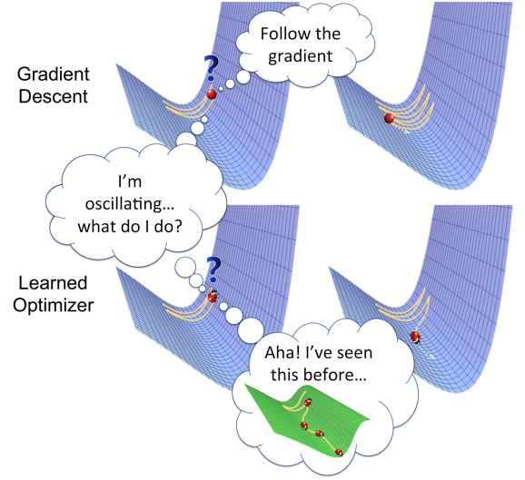
Optimization Techniques

Slide 44
Optimization Techniques
Explanation of Maxima and Minima
In mathematics and optimization problems, Maxima and Minima refer to the highest and lowest values that a function can take, respectively.
Maxima: The largest value a function reaches within a given domain or range.
Minima: The smallest value a function reaches within a given domain or range.

Slide 45
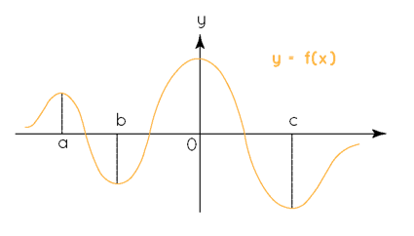
Optimization Techniques
Explanation of Maxima and Minima

Slide 46
Optimization Techniques
Global Maxima and Minima
Global Maximum: The highest point of a function over the entire domain. No other value in the function is greater than this.
Global Minimum: The lowest point of a function over the entire domain. No other value in the function is smaller than this.

Slide 47
Optimization Techniques
Local Maxima and Minima
Local Maximum: A point where the function reaches a peak within a specific region or range, but there may be higher points elsewhere in the function.
Local Minimum: A point where the function reaches a trough within a specific region, but there may be lower points elsewhere.

Slide 48
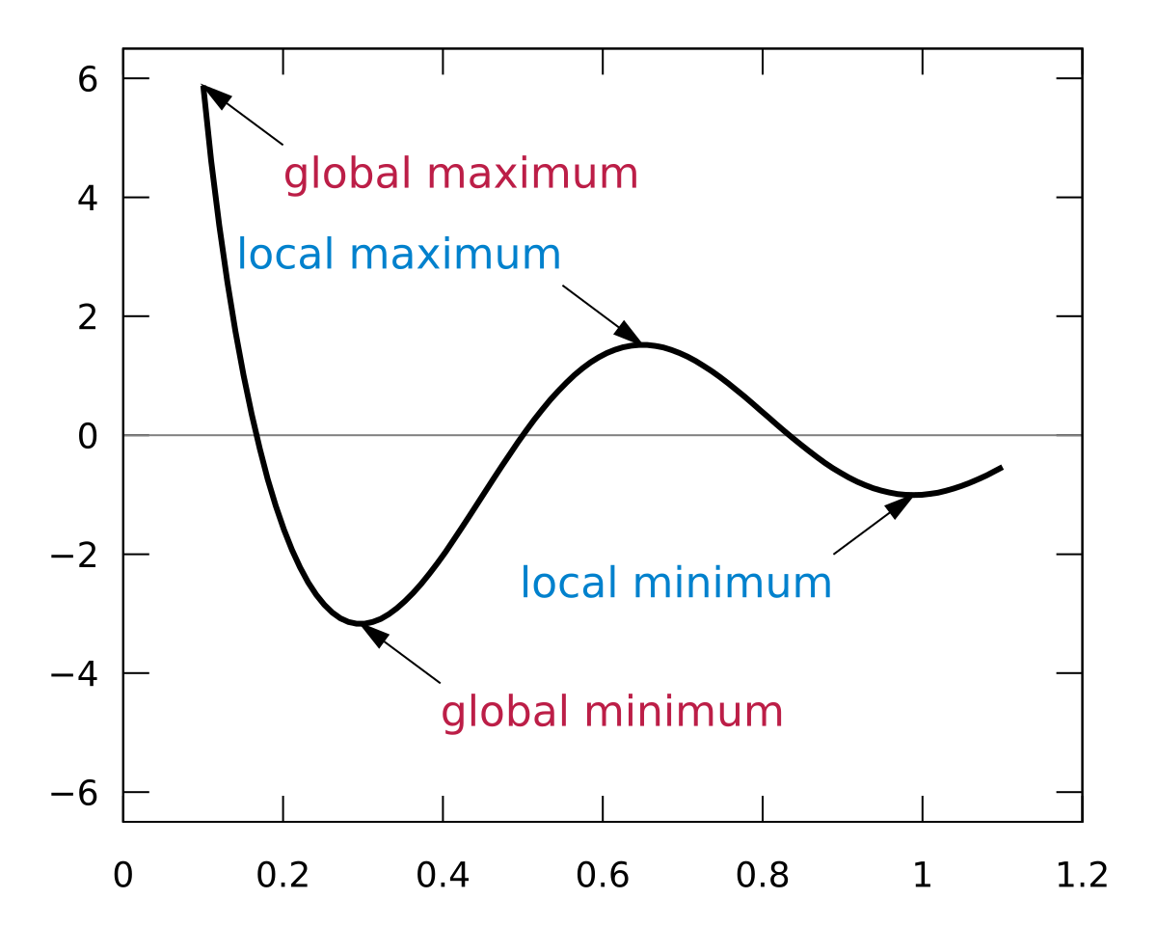
Optimization Techniques
Global & Local Maxima and Minima

Slide 49
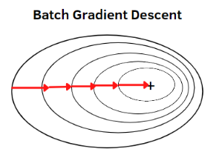
Optimization Techniques
Gradient Descent Variants
1. Batch Gradient Descent
How it works ?
The entire training dataset is used to compute the gradient and update the weights. This method is computationally expensive for large datasets.
Pros: Accurate gradient computation.
Cons: Slow and resource-intensive for large datasets.

Slide 50
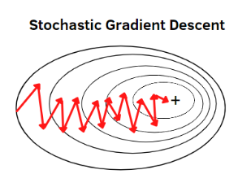
Optimization Techniques
Gradient Descent Variants
2. Stochastic Gradient Descent (SGD)
How it works ?
SGD updates the weights after each training sample. Instead of using the entire dataset, it uses one sample at a time to compute the gradient and update the weights.
Pros: Faster than Batch Gradient Descent, and it introduces noise into the updates, which helps escape local minima.
Cons: The gradient estimates are noisy, and it can take longer to converge.

Slide 51
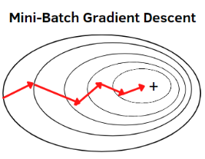
Optimization Techniques
Gradient Descent Variants
3. Mini-batch Gradient Descent
How it works ?
Instead of using the entire dataset or a single sample, mini-batch gradient descent uses a small random subset (or batch) of data to compute the gradient and update the weights.
Pros: A balance between efficiency and speed, commonly used in practice.
Cons: The batch size needs to be carefully chosen (too small = noisy, too large = slow).

Slide 52
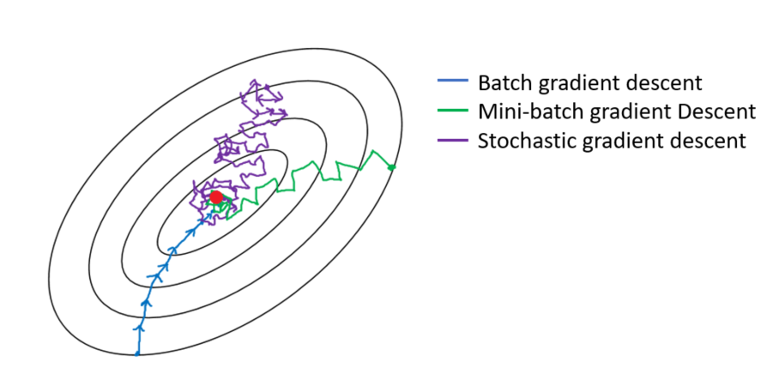
Optimization Techniques
Gradient Descent Variants

Slide 53
Optimization Techniques
Advanced Optimization Algorithms
1. Momentum
How it works ?
Momentum helps accelerate gradient descent by adding a fraction of the previous update to the current update. This helps the algorithm converge faster, especially in regions with high curvature.
Why it helps ?
Momentum helps smooth out the updates and prevents oscillations, leading to faster convergence

Slide 54
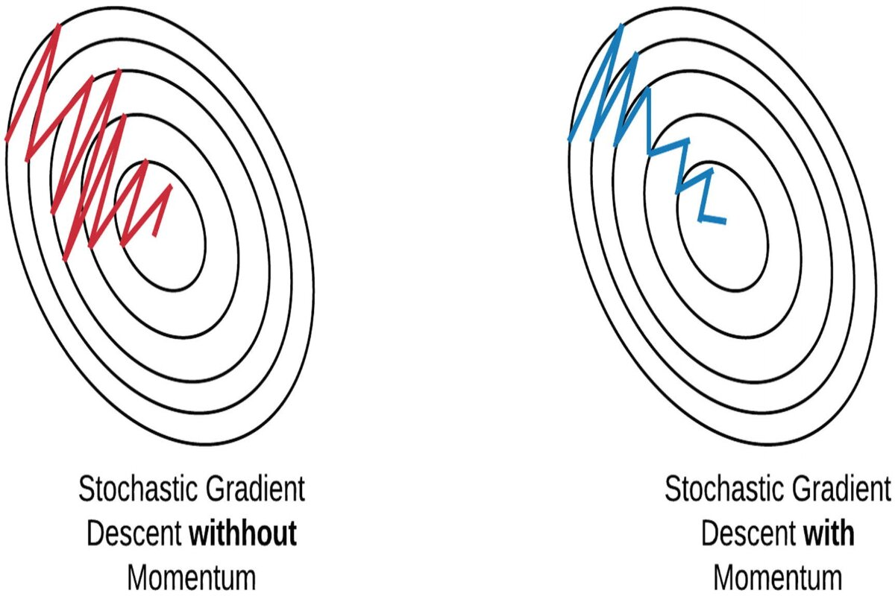
Optimization Techniques
Advanced Optimization Algorithms
1. Momentum
Momentum in gradient descent accelerates convergence by adding a speed parameter, reducing fluctuations, and smoothing the path toward the global minima, but it can overshoot if the learning rate is too high.

Slide 55
Optimization Techniques
Advanced Optimization Algorithms
2. Adam (Adaptive Moment Estimation)
How it works ?
Adam combines the advantages of both RMSProp and Momentum. It uses an adaptive learning rate and maintains per-parameter learning rates based on moving averages of past gradients.
Why it helps ?
Adam adapts the learning rate for each parameter individually, which allows for faster and more efficient convergence.

Slide 56
Optimization Techniques
Advanced Optimization Algorithms
2. Adam (Adaptive Moment Estimation)
Popular in Practice
Adam is one of the most commonly used optimization algorithms due to its efficiency and effectiveness in training deep learning models.

Slide 57
Key Takeaways
Deeper Neural Networks allow the model to learn complex hierarchical features but come with challenges like the vanishing gradient problem, which can be solved using proper activation functions like ReLU.
Overfitting occurs when the network learns to memorize the training data instead of generalizing well. To prevent this, techniques like L2 regularization, dropout, and early stopping are used to regularize the network.
Optimization Techniques like Adam and Momentum are advanced methods to make gradient descent more efficient and help the model converge faster.

